Slide 1
STYLEHIVE
List of Entities
Conceptual ER Diagram
Logical ER Diagram

Slide 2
STYLEHIVE : LIST OF ENTITIES
Entity Name | Entity Primary Attributes
User | User_id, firstName, lastName, password, email, role, mobile, Address_id,Payment_id, Rating_id, Review_id, createdAt
Review | Review_id, Review, User_id, createdAt
Rating | Rating_id, User_id, Product_id, Rating, createdAt
Product | Product_id, Title, Description, Price, Discountedprice, DiscountPercent, Quantity, Brand, color, Sizes, ImageUrl, Rating_id , Review_id, NumRatings, Category_id, createdAt
OrderItem | OrderItem_id, Product_id, Size, Quantity, Price, DiscountedPrice, User_id
Order | Order_id , user, OrderItems, OrderDate, DeliveryDate, ShippingAddress, PaymentDetails, TotalPrice, TotalDiscountedPrice, Discount, OrderStatus, TotalItem, createdAt
Category | Category_id, Name, ParentCategory, Level
CartItem | CartItem_id, Cart_id, Product_id, size, quantity, price, discountedPrice, User_id
Cart | Cart_id, CartItem_id , totalPrice, totalDiscountedPrice, User_id
Address | Address_id, firstName, lastName, streetAddress, city, state, zipCode, User_id, mobile
Payment Information | Payment_id, User_id, cardNumber, cardHolderName, expiryDate, CVV, Address_id, paymentType, createdAt
Advertiser | advertiser_id, company_name, contact_person_name,contact_person_phone_number, contact_person_email, ad_start_date, ad_end_date, ad_cost, paid, payment_id

Slide 3
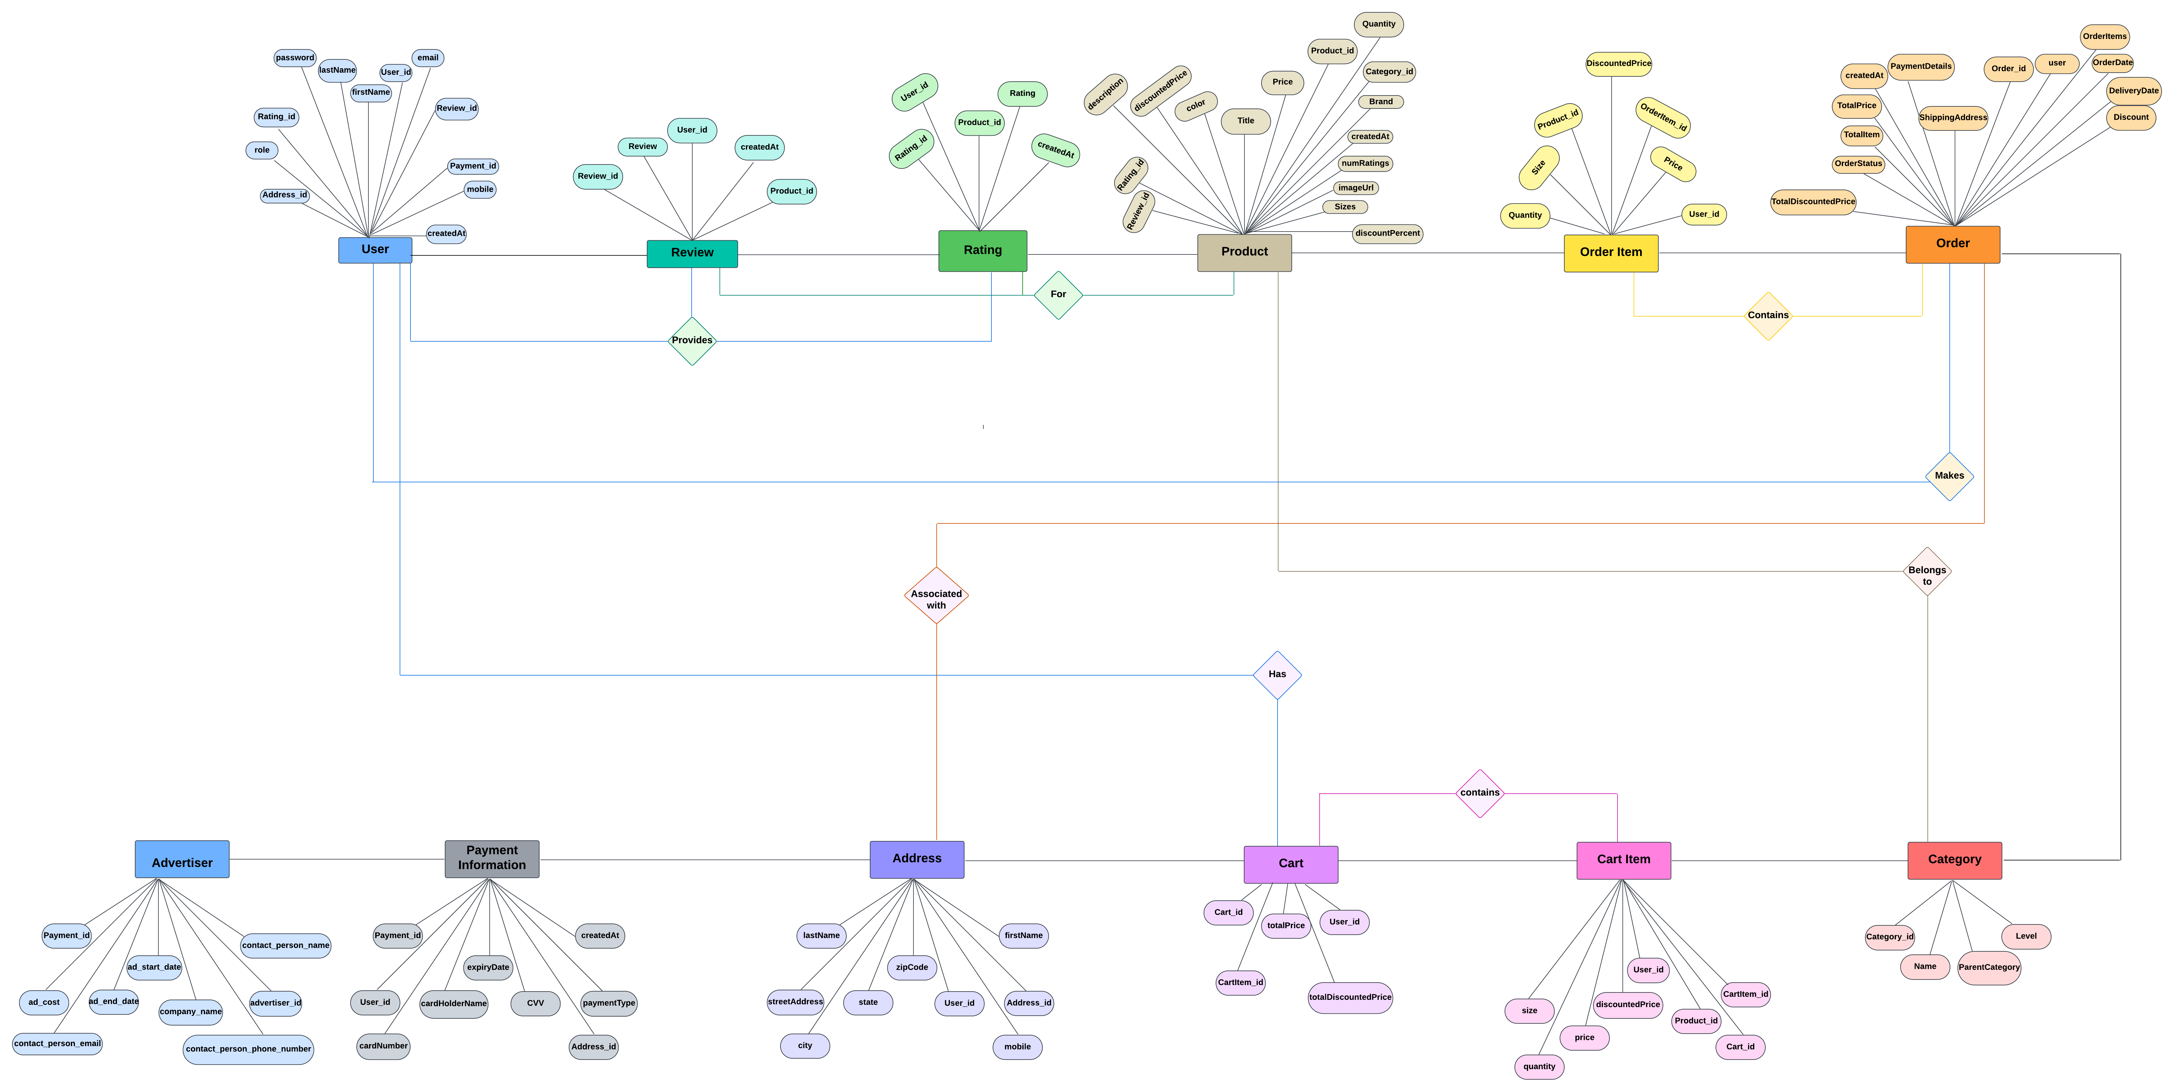
CONCEPTUAL ER DIAGRAM

Slide 4
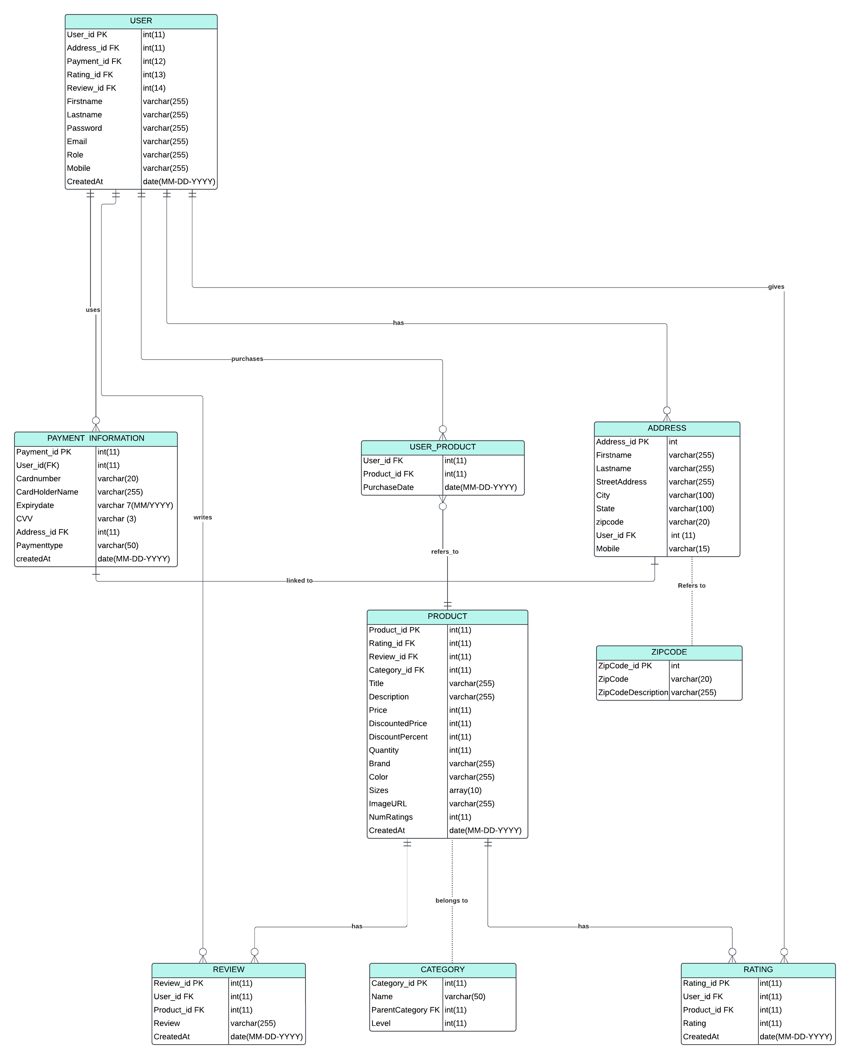
LOGICAL ER DIAGRAM

